Slide 1
SHEILA MURUGI MUNYIRI
E033-01-1366/2020
BED CIVIL ENGINEERING
EVOLUTION OF FLYOVERS

Slide 2
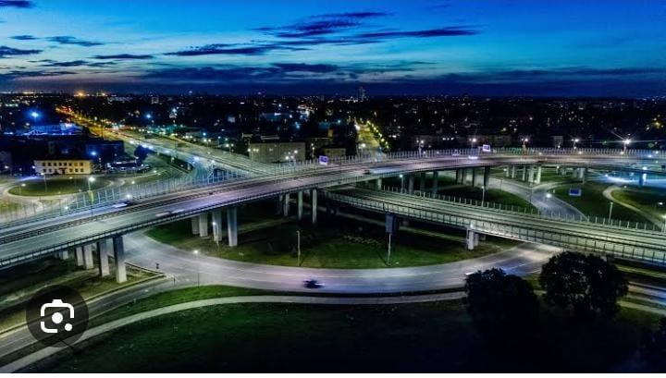


Slide 3

It is a bridge structure that is built to enable traffic to flow over an obstacle or intersection typically another road.
Flyovers are also known as an overpass

Slide 4

When was it built?
Where was the first flyover built?
Who designed the first flyover?

Slide 5
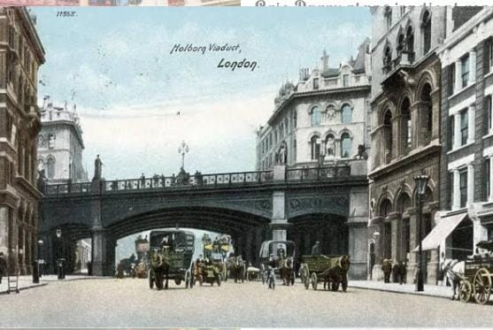
Holborn Viaduct was the world's first flyover, connecting Holborn with Newgate street, to avoid a dip on the road. It was built between 1863 and 1869 and opened by Queen Victoria in 1869
Notable engineers such as Eugene Henard the French urban planner contributed to development of flyovers.

Slide 6

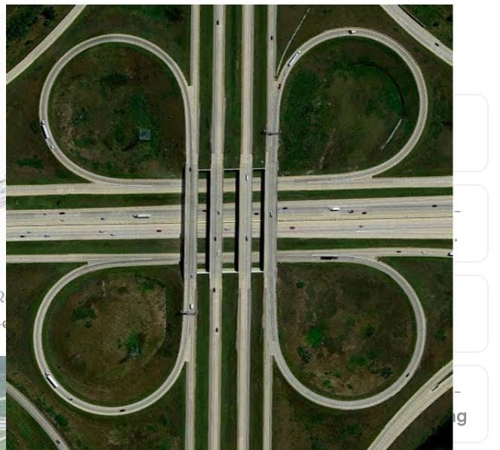
TYPES OF FLYOVERS
Grade separated flyovers
2. Cloverleaf flyovers
Grade separated flyovers are the most common type of flyovers and are built to separate conflicting traffic movements. They are multi-level structures that allow traffic from one road to pass over another without any interruption. These flyovers are typically found at busy intersections, interchanges, or highway crossings
consists of a series of circular ramps that allow vehicles to enter and exit the flyover, resulting in a continuous flow of traffic. This type of flyover is suitable for large volume traffic and is commonly used at major highway intersections.

Slide 7
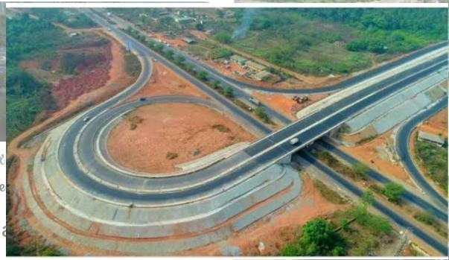
3. Trumpet flyovers
they have a more simplified design with only one circular ramp on one side and a straight ramp on the other side. This type of flyover is cost-effective and requires less land area compared to cloverleaf flyovers. It is commonly used to connect highways with urban roads or collector roads.

Slide 8

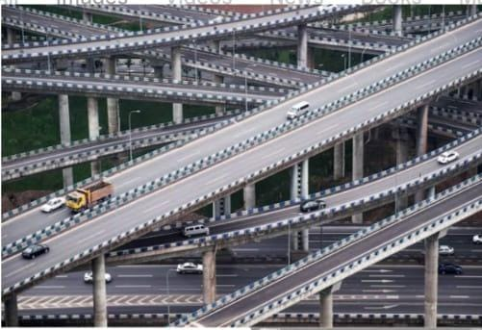
4. Stack flyovers
also known as a double-decker flyover, is a complex structure that consists of two or more levels of cloverleaf or trumpet flyovers. It is used to connect multiple roads or highways, resulting in a smoother traffic flow and reduced congestion. Stack flyovers are commonly seen in major cities with a high volume of traffic.

Slide 9
ADVANATGES OF FLYOVERS
1. Traffic flow improvement- facilitate smoother traffic movement by reducing congestion at ground level.
2. Enhanced safety- separate conflicting traffic streams, reducing risk of accidents. Also enhance safety for pedestrians
5. Aesthetics- well designed flyovers enhance visual appeal of urban places.
3. Optimized land use – utilize vertical space efficiently allowing for construction of additional lanes without cutting on valuable ground level estate.
4. Economic benefits- enhance accessibility to commercial centres and facilitate smoother movement of goods and services

Slide 10
1. High construction and maintenance costs – need specialized engineering, materials and labour costs
DISADVANTAGES OF FLYOVERS
2. Limited accessibility for pedestrians – prioritize vehicular traffic.
3. Environmental impact – their erection can lead to loss of green space and disruption to natural drainage patterns.

Slide 11
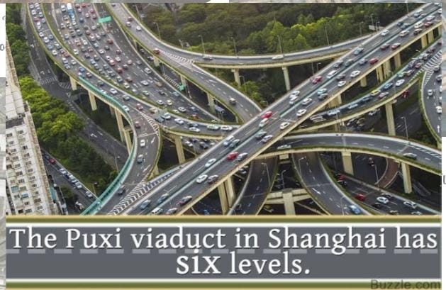


Slide 12

The world is changing with the dawn of each new day a new invention been discovered. In the transport realm, as we have seen flyovers have evolved significantly and more trends in their construction are been witnessed.

